Slide 1

7,000 ethnic groups!
30% of the world’s population!
It is impossible!
©Depositphotos.com/Viktoria Protsak

Slide 2
With a Historical Perspective …
We can do it!
©Depositphotos.com/Daria Karaulnik

Slide 3

From the Apostles to 400 A.D.
The church broke with the traditions of Judaism.
John presented the gospel for the Greeks; Peter ended up in Rome; Thomas went to India; Paul wanted to go to Spain.
©Depositphotos.com/Liubov Bunakova

Slide 4
The Four Missionary Mechanisms in the Bible
Go Voluntarily: Paul and Barnabas are sent out in Acts 13.
Go Involuntarily: The Christians are scattered by persecution in Acts 8.
Come Voluntarily: The Jews come to Pentecost in Acts 2.
Come Involuntarily: Cornelius comes to Palestine as a soldier under orders in Acts 10.

Slide 5
Miraculous Growth
The church maintained a good testimony with its morality, love, and acts of service.
The Christians remained faithful in the face of persecution.
The church responded to intellectual attacks from paganism, while internally resisting various heresies.
There was an army of itinerant evangelists (3 John 5-8).

Slide 6

Non-Christian Practices and the Catholic Church
The church assimilated beliefs and practices from the cultures and mystery religions of the time.
The church became a dispensor of salvation through the sacraments.
The Emperor Constantine declares himself Christian (312 AD), and the Catholic Church is formed.
The church was invaded by multitudes with little Christian conviction.
The Christian church united with the Roman Empire.
The church conquered the Roman Empire but, paradoxically, the empire conquered the church!
_{©Depositphotos.com/S_Kohl}

Slide 7
Christianity in the year 400 A.D.
ATLANTIC
OCEAN
EUROPE
ASIA MINOR
AFRICA

Slide 8
The Barbarians and Islam
(400 to 800 A.D.)
With the Roman Empire in decline, the Barbarians invaded from the north.
The mechanism of coming voluntarily: If you do not go to the unreached…
The Barbarians were won to the faith.
The Barbarians respected the churches. The church maintained order and written history during a time of chaos.

Slide 9
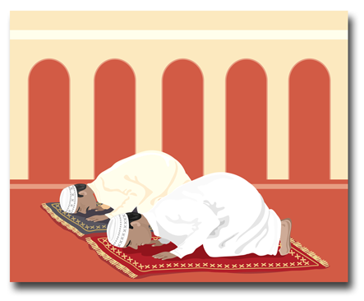
Islam arose and conquered the Middle East, the north of Africa, and Spain.
Examples of prominent missionaries: Columba and Boniface
Charlemagne, the Holy Roman Empire, and non-recommended missionary methods
_{©Depositphotos.com/Mike Smith}

Slide 10
Christianity in the year 800 A.D.
ATLANTIC
OCEAN
EUROPE
ASIA MINOR
AFRICA

Slide 11
The Crusades and the Vikings
(800 to 1200 A.D.)
The Christian faith was imposed by force during the Crusades.
The Crusades failed to reach their objectives and have hardened the Muslims to the gospel to this day.
©Depositphotos.com/114655068_s-2015

Slide 12

The church split between the Catholic and the Orthodox in 1054.
The Nestorian Church grew all the way to China, but was extinguished by Ganges Khan and the Muslims.
The Vikings from Scandinavia invaded and devastated the churches, and were eventually won to the faith.
Many superstitions corrupted the church.
©Depositphotos.com/Tribaliumivanka

Slide 13
Christianity in the year 1200 A.D.
ATLANTIC
OCEAN
EUROPE
ASIA MINOR
AFRICA

Slide 14

The Renaissance and the Reformation (1200 to 1600 A.D.)
Studies, universities, and the printing press
The Reformation corrected abuses of the Catholic church.
For 250 years Protestants did not form mission agencies.
The Catholics were sending many missionaries!
©Depositphotos.com/Alexandru Romanciuc/arogant

Slide 15
Christianity in the year 1600 A.D.
ATLANTIC
OCEAN
EUROPE
ASIA MINOR
AFRICA

Slide 16
Modern Missions – The First Wave to the Coasts (1792 to 1910)
The Moravians
Pioneer – William Carey
His book – An Inquiry into the Obligation of Christians to Use Means (mission agencies) for the Conversion of the Heathens
The response:
“Be quiet, young man!”

Slide 17

Carey went to India.
His example spawned 3 mission agencies in England, 2 in Scotland, and 1 in the USA. 25 years later 12 agencies had been formed in Europe and the USA.
Europe dominated.
Achievements - the
coasts of Africa and Asia
In Africa few missionaries
lasted more than a few
years. They packed
their belongings in
caskets!
©Depositphotos.com/Maxim Kazmin/Michael Bescec

Slide 18
Approximate Extension of the Evangelical Church at the End of the First Wave (1910)

Slide 19
The Second Wave to the Interiors of the Continents (1865 to 1980)
The pioneer, Hudson Taylor, studied statistics on the population of China.
He founded the China Inland Mission; they have sent out 6,000 missionaries.

Slide 20
40 new mission agencies were formed.
Achievements – the interiors of the great continents.
The United States dominated.
At first they paid no attention to the lessons learned in the first wave.
There was a great missionary movement from the universities.

Slide 21
Approximate Extension of the Evangelical Church at the
End of the Second Wave, plus Recent Advances

Slide 22
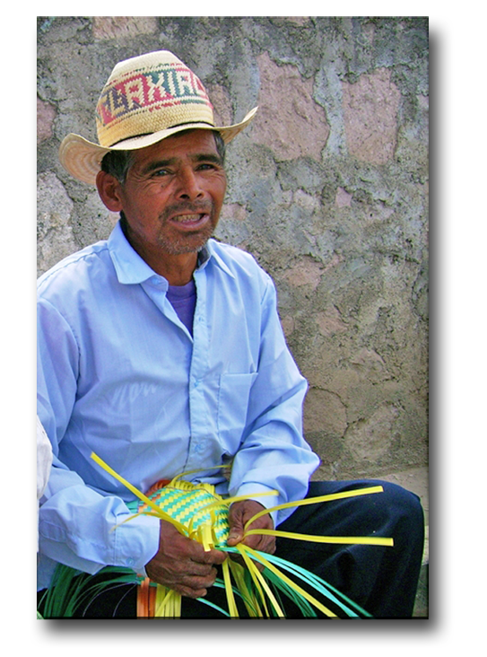
The Third Wave to the Unreached Ethnic Groups (1940 to Presente)
If your God is so smart, why doesn’t he speak my language?
Pioneers - Cameron Townsend in Guatemala and Donald McGavran in India
A humble Indian asked Townsend a question, and Wycliffe Bible Translators was formed!
Photo by Alejandro Rodríguez

Slide 23
In India, McGavran ran into the caste system.
They both independently discovered the biblical concept of ethnic groups.
Achievements – identifying and reaching unreached ethnic groups.
Many new specialized mission agencies.
Surprising growth of the church in the developing world.

Slide 24
¡From Receivers to Senders!
©Depositphotos.com/Maksym Yemelyanov

Slide 25

The Current Situation
Mission agencies in Asia, the Pacific Islands, Africa, and Latin America
COMIBAM was formed in 1987.
The growth of COMIMEX
400 missionaries in ’87; 4,000 in ’97; 6,000 in 2000; 8,000 in 2006, and now?!
Cooperative networks and strategic alliances

Slide 26
Applications and Conclusions from History
A lack of missionary vision at various times.
Conflicts within the church distract from the vision.
The church and politics
The lack of structures

