Slide 1
Prayer is the motor for cross-cultural missions.
“When men work,
Men work;
When men pray,
God works.”
Hans Von Staden

Slide 2

The Call for Missions Prayer
We pray according to God’s will, and his will is to reach all nations.
It is our priestly function.
The Lord’s Prayer… “Thy kingdom come!”
Jesus says in Matthew 9:38, “Ask the Lord of the harvest, therefore, to send out workers into his harvest field.”
Missions were born through prayer and fasting (Acts 13:1-4).
Paul asked for prayer for his ministry (Romans 15:30).
_{©Depositphotos.com/}
_{Bobby Wijaya}

Slide 3
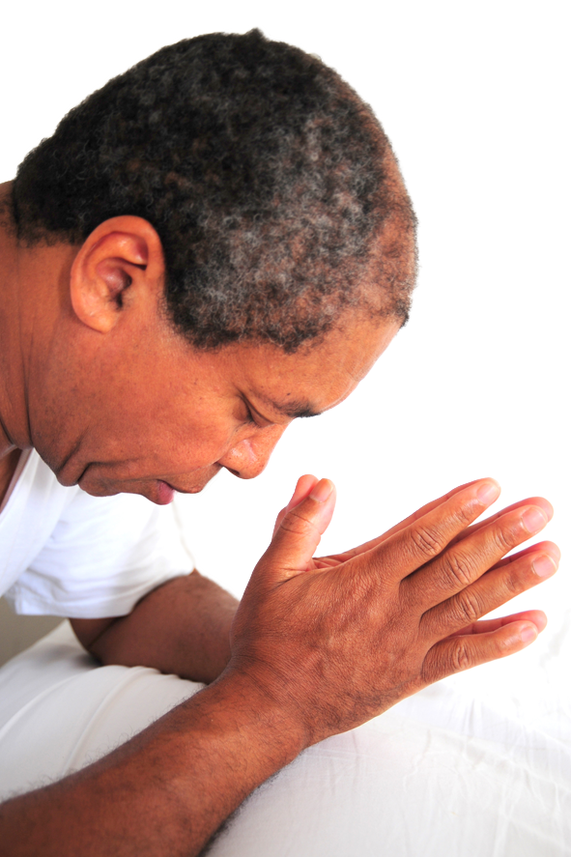
The Search for Information for Missions Prayer
Oh God,
Bless the world;
Bless the missionaries.
Bless the world;
Bless the missionaries.
Bless the world;
Bless the missionaries...
Prayer for missions can quickly become monotonous without current information.
©Depositphotos.com/Oscar Williams

Slide 4
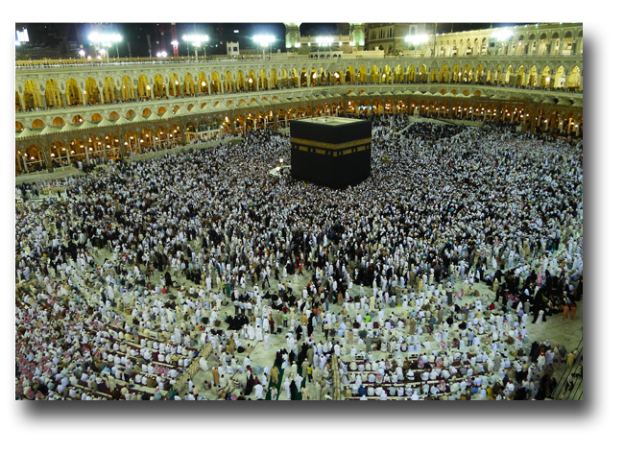
Petitions for Missions Prayer
Prayer for the Mission Fields
©Depositphotos.com/Mohamad Shahreen Amri

Slide 5
The great need for workers for the harvest
The different ethnic groups within and outside of Mexico, particularly those where the gospel has not yet penetrated
Preparation of the people’s hearts for when the seed of the gospel is sown
The opening of closed countries, and for their governments
Open doors to present the gospel

Slide 6
Against the principalities of darkness over the country, region, or city
For the gospel to spread through the ethnic group
To halt the advance of false religions such as Islam and Hinduism
The healing of the land
The specific needs of each place

Slide 7
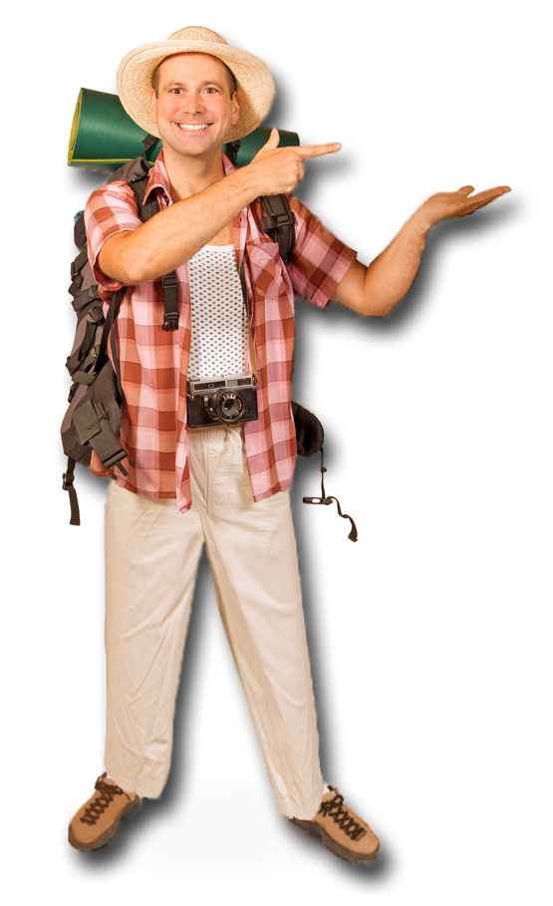
Prayer for the Missionaries
The missionary’s relationship with God
The missionary’s good testimony
The missionary’s health, energy, and recreation
The missionary’s family, his/her spouse and children
The missionary’s ability to learn a new language and culture
Wisdom for the missionary and success in his/her ministry
That the fruit would endure in the new believers
Against the opposition or persecution he/she may encounter
Against the spiritual opposition to which he/she is subjected
©Depositphotos.com/Milan Vasicek

Slide 8
Wisdom to speak and make decisions
Grace to relate to other team members
A clear vision for the ministry
That there be no lack of economic, moral, or prayer support
Against the natural tendency to impose the missionary’s own culture together with the gospel
The missionary’s travels
Liberation from dangers
The specific needs of each missionary

Slide 9
Prayer for the New Church
Maturity and good testimony among the believers
Good understanding between the missionary and the church
For lasting fruit
The participation of all the believers in the ministry
Against misunderstanding the gospel and the danger of syncretism
Against legalism and traditionalism into which it’s easy to fall

Slide 10
Fellowship, as in the early church in Jerusalem
Protection from the enemy

Slide 11
Resources for Missions Prayer
www.etnopedia.org
Impact 316 Prayer Cards (Spanish)

Slide 12
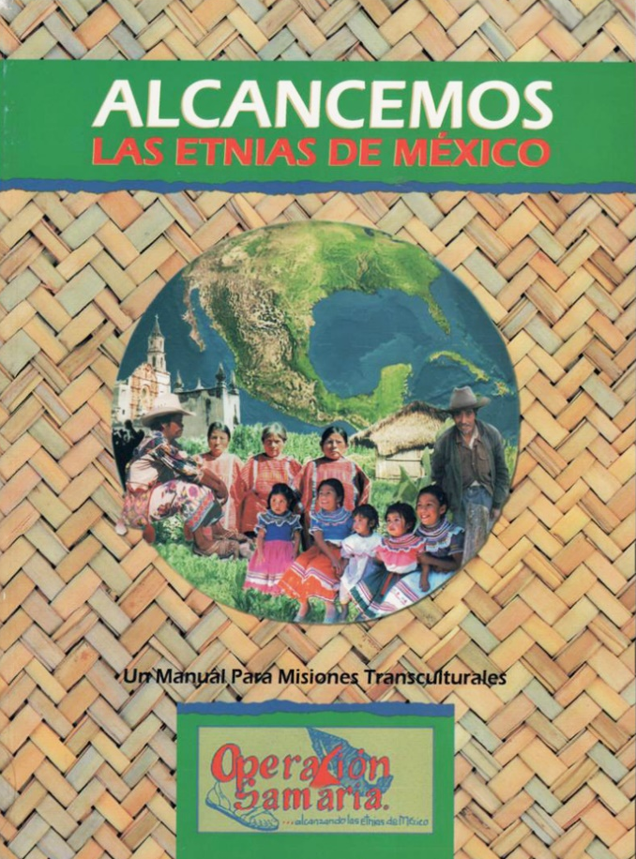

Slide 13
Proyect Joshua
Be Part of the Million
(Spanish)

Slide 14

Opportunities for
Prayer in the Church
Personal and family devotions
Pastoral prayer from the pulpit
Cell groups, Bible study groups, and Sunday school
Prayer vigils
A “missions minute” during the worship service
Youth groups, women’s groups, men’s groups
New activities in the local church or with other churches exclusively for missions prayer
©Depositphotos.com/
Viktoria Protsak

Slide 15
What would it be like if every Christian prayed for 5 minutes a day for world missions?

